Slide 1
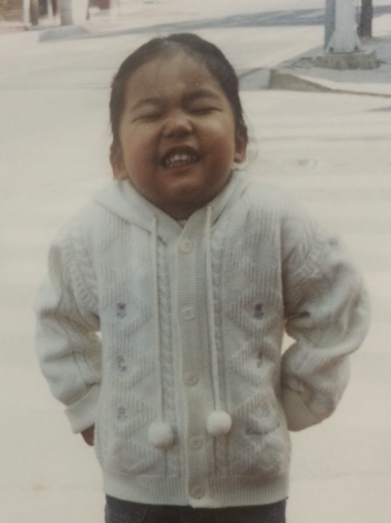

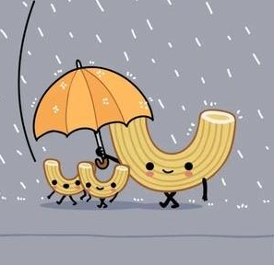
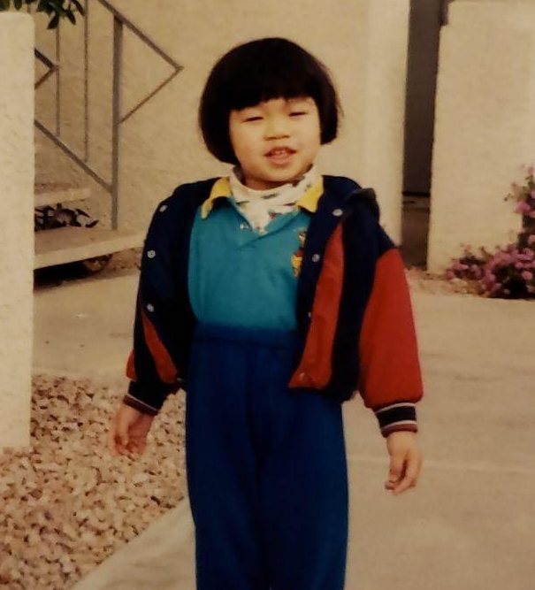
Team MAC (and cheese) updates
Migon Choi (Duke University)
Aaron Peng
(University of Chicago)
Jan 20, 2023
Source: @wawawiwacomics
Cindy Wong (University of Illinois Urbana-Champaign)

Slide 2

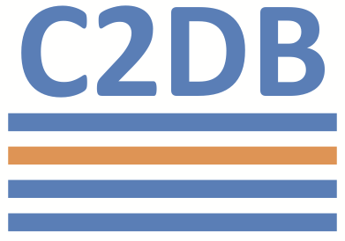

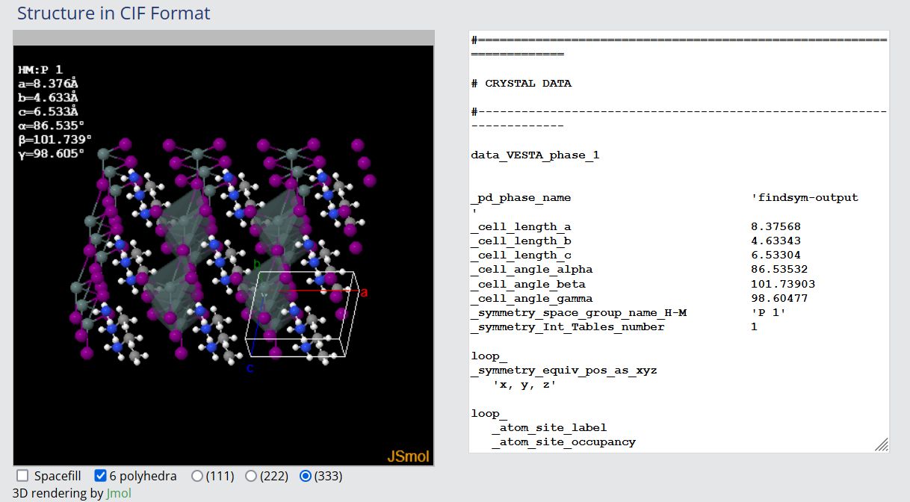

Our JourneyTM to realizing databases suck (more)
23,112 ABX3 materials
7 0 useful features that aren’t used for calculating EBE labels
120 ABX3 materials
101 features
Annoying to extract
34,940 1,639 ABX3 materials
23 features
Only 47 EBEs
1346 ABX3 materials with E_{gap} and ε_{r}
1346 .cif structure files obtained from hacky HTML requests

Slide 3
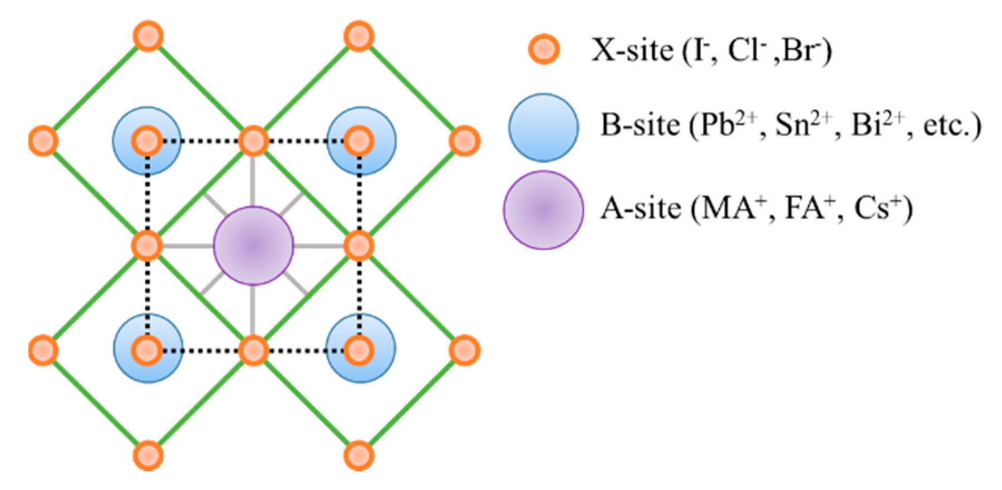
We will compare the electronic and ionic dielectric constants in determining exciton binding energies
E
ε_{ionic} VS ε_{elec}
Source: http://depts.washington.edu/cmditr/mediawiki/index.php?title=Polarization_and_Polarizability

